Slide 1
FLOWER RECOGNITION USING CNN
SUBMITTED TO:
PROF. VANDANA KATE
SUBMITTED BY:
SAHAJ MAKWANA: 0827CI191049
UTKARSH SHRIVASTAVA: 0827CI191061

Slide 2
PROBLEM STATEMENT
The proposed flower recognition system is implemented by developing a convolutional neural network which is a very efficient model for image classification. CNN models are trained by initially feeding a set of flower images along with their labels.

Slide 3
ALGORITHM USED
CNN: CNN is a type of deep learning model for processing data that has a grid pattern, such as images

Slide 4
APPROACH
First we import the necessary Python libraries to get started with the task of Flower Recognition with Python:
Then we Read each image in the data and create a label for each with the name of the folder:
Then convert the data into numerical values:
use the Label encoder and normalize the data:
split the dataset into 80% training and 20% test sets:
let’s build a neural network model for the task of Flower Recognition:
create more training images to prevent overfitting:
compile the neural network model:
let the model if it recognize flowers properly:

Slide 5
IMPLEMENTATION:
GITHUB:
https://github.com/utkarshri/ml-project
DATA SET
https://thecleverprogrammer.com/2020/11/24/flower-recognition-with-python/

Slide 6
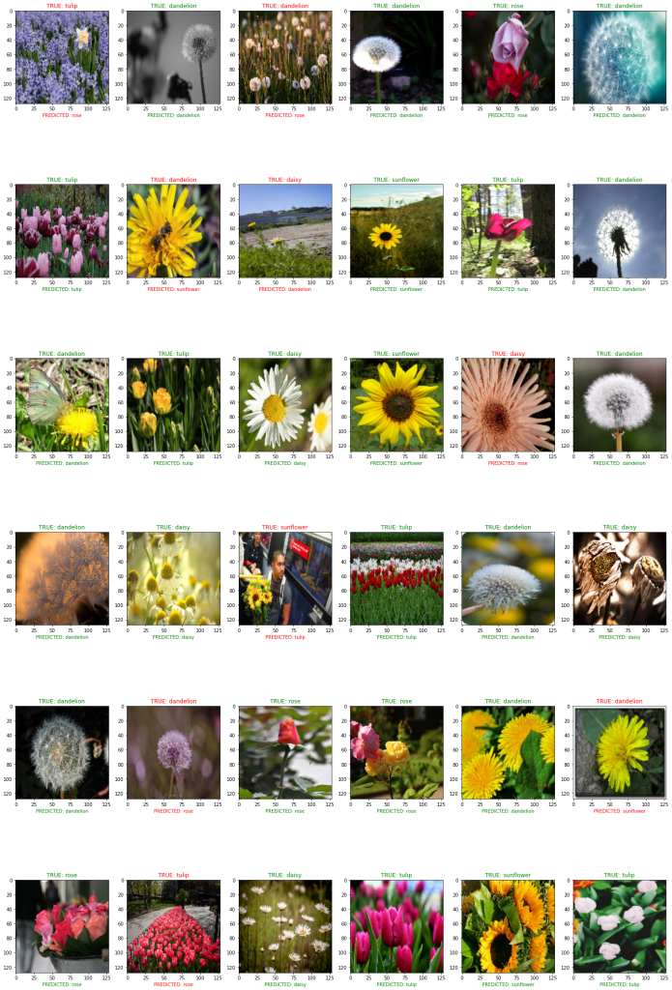

Slide 7
RESULT
While testing this model, we are getting a ~85% accuracy for the testing dataset

